Slide 1
2019 TUDA NAEP Results for Miami-Dade
A-1
Notes:
On October 30, 2019, the 2019 NAEP TUDA results were released.
NAEP is considered the Nations Report Card and is the largest continuing evaluation of education in the United States
The NAEP TUDA compares the results of district performance over time and with other districts.
In 2019, 27 districts participated.
NAEP is the gold standard and allows us to examine the result s of M-DCPS in comparison to the nation, large cities and other urban districts.
NAEP TUDA is administered every 2 years in grades 4 and 8, in reading and mathematics.

Slide 2
What is NAEP TUDA?
NAEP — known as The Nation's Report Card — is the largest continuing, nationally representative evaluation of education in the United States.
The NAEP Trial Urban District Assessment (TUDA) results show how school districts are performing over time and compared with other participating districts ( 27 districts participated in 2019).
NAEP is the gold standard and compares M-DCPS students’ performance to the Nation and other large urban districts.
NAEP TUDA is administered in grades 4 and 8 in Reading and Mathematics every two years.
Notes:
Read slide

Slide 3
Highlights for Miami-Dade County NAEP TUDA
Nationally, M-DCPS fourth graders ranked #1 in Reading and Mathematics.
M-DCPS’ NAEP scores were significantly higher than public schools nationwide in Grade 4 Reading and Mathematics.
M-DCPS eighth graders’ scale scores ranked #2 in Reading and #6 in Mathematics on the 2019 NAEP assessments, up from rankings of 5th and 10th, respectively, on the 2017 administration.
While the three Florida districts that participate in the TUDA program scored among the top districts nationwide, M-DCPS met or exceeded the mean scale scores received in both Hillsborough and Duval Counties across all four grade level/content areas.
Notes:
Read slide
(Rankings are among the other 27 TUDA districts.)

Slide 4
Highlights for Miami-Dade County NAEP TUDA – Subgroups
Hispanic students in M-DCPS continued their outstanding performance on NAEP, again achieving higher Reading and Mathematics scores in all tested grade levels than both the National Public and Large City school samples.
Black students in M-DCPS achieved higher mean scores than National Public and Large City school samples in Grade 4 Reading and Mathematics. They also scored higher than Large City samples in Grade 8 Reading.
M-DCPS Students with Disabilities scored higher than the Large City sample in all grades and content areas tested.
Students who are eligible for the free/reduced price lunch program outscored their counterparts in both the National Public and Large City school samples in all grades and content areas tested.
Notes:
Read slide

Slide 5
2019 NAEP Reading, Grade 4
Notes:
Miami-Dade 4th graders were ranked #1 in Reading across all the other jurisdictions with a scale score of 225.
Further review of disaggregated data indicate the MDCPS’ 4th grade students’ scale scores exceeded the national public school and large city sample in almost all the subgroups in both Reading AND Mathematics.

Slide 6
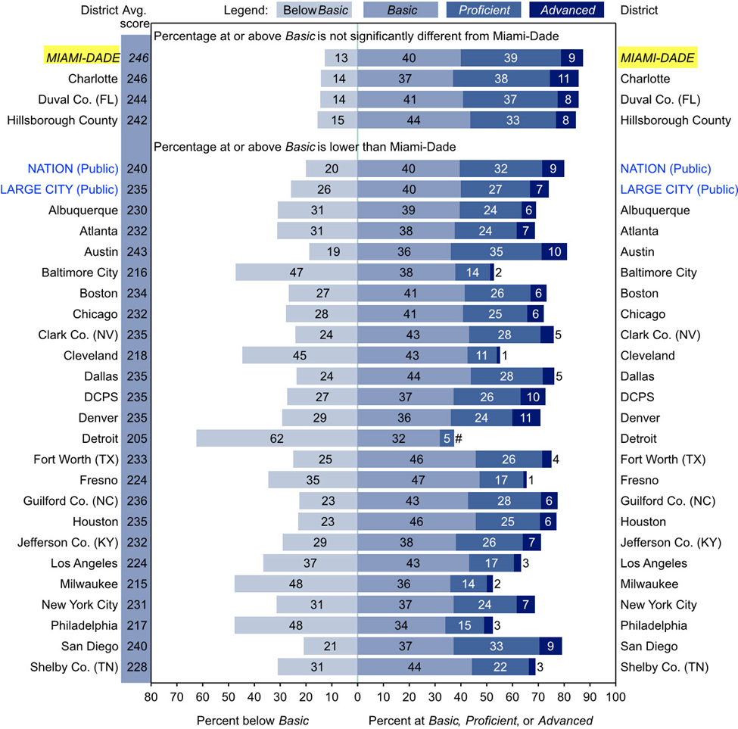
2019 NAEP Mathematics, Grade 4
Notes:
Similarly, 4th graders were ranked #1 in Mathematics across all the other jurisdictions with a scale score of 246.

Slide 7
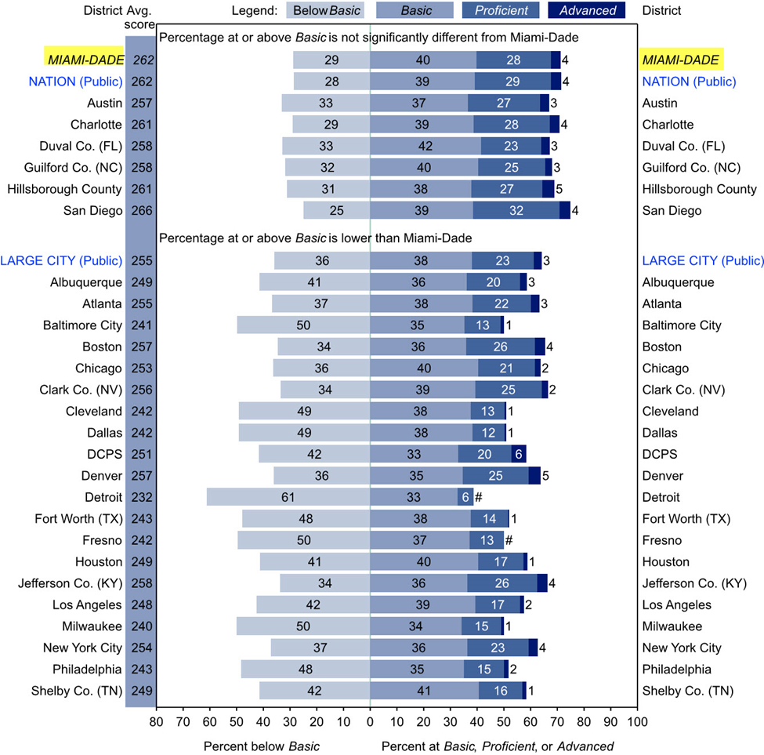
2019 NAEP Reading, Grade 8
Notes:
MDCPS’ 8th graders ranked #2 in Reading in the nation with a scale score of 262

Slide 8
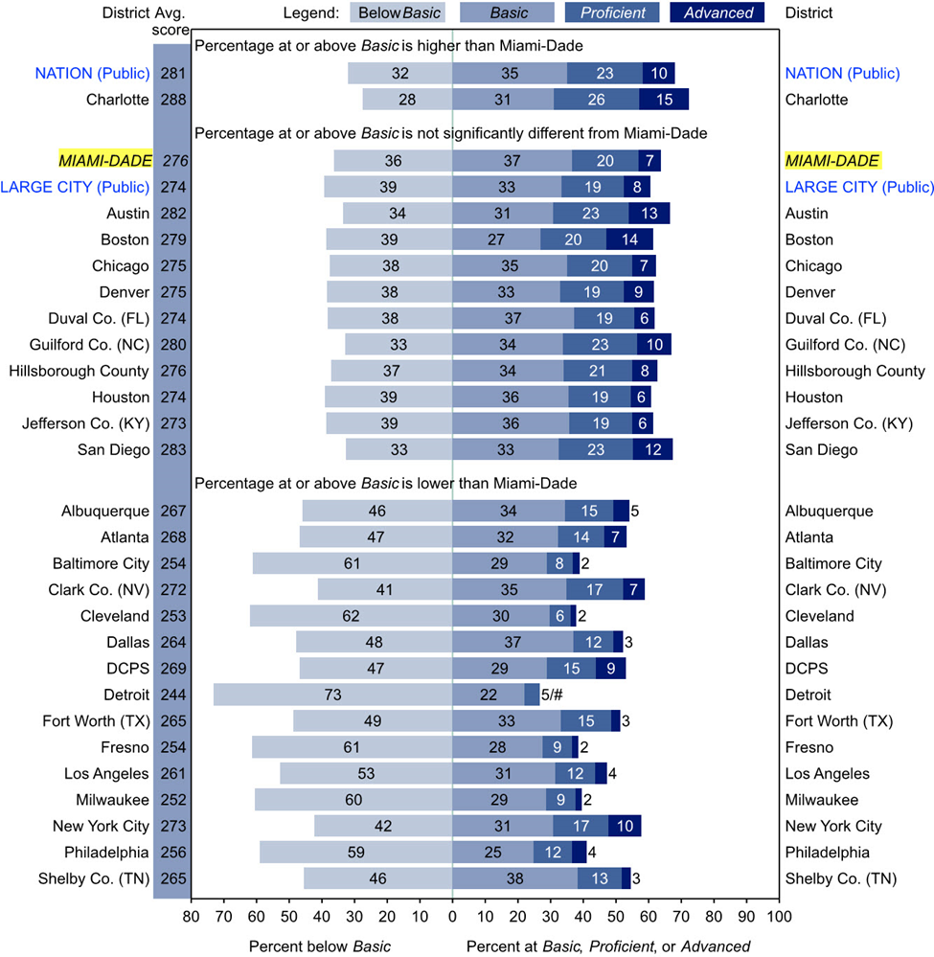
2019 NAEP Mathematics, Grade 8
Notes:
MDCPS’ 8th graders ranked #6 in Mathematics in the nation with a scale score of 276

Slide 9
The Bottom Line
NAEP is the gold standard and compares M-DCPS students’ performance to the Nation and other large urban districts.
Nationally, M-DCPS fourth graders ranked #1 in Reading and Mathematics.
M-DCPS eighth graders’ scale scores ranked #2 in Reading and #6 in Mathematics.
Notes:
The bottom line ……

